Slide 1
Magneto-Optic Effect
When optically inactive material such as glass placed in a strong magnetic field and a plane polarized light sent along the direction of magnetic field, it is found that emerging light’s plane of polarization has been rotated. This is called a faraday effect.
The amount of rotation θ is given by
θ = B L ϑ
Where B = Magnetic flux density
L = Length of the Medium
ϑ = Verdet constant
ϑ is depend on material and wavelength

Slide 2
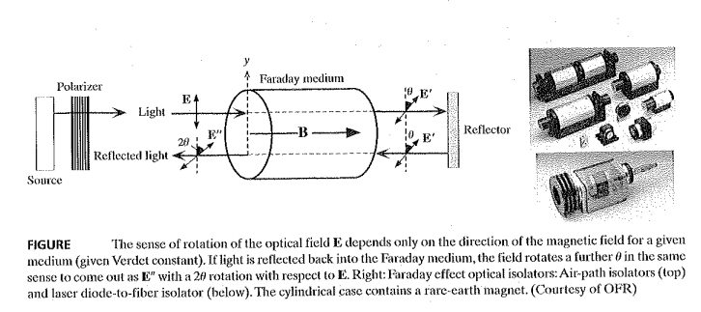

Slide 3
The light source is isolated from Reflections by using optical isolator.
Optical isolator consists of a polarizer and Faraday rotator.
Faraday rotator rotates field by 45 degrees.
The reflected light will have a angle of 90 degrees of rotation. It will not pass through polarizer back to the source.

Slide 4
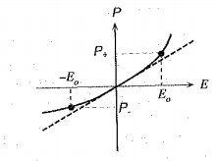
Second Harmonic Generation (SHG)
The application of electric field ‘E’ to the dielectric material causes it’s atoms and molecules to become polarized.
In linear dielectric material, induced polarization P proportional to electric field E.
P=ϵo χ E
Where χ = electric susceptibility
this linear relation fails for higher values of E shown in figure below
Fig. Induced Polarization ‘P ‘ versus Electric field ‘E’

Slide 5

For higher values of Electric field ‘E’, the induced polarization can be represented as non-linear Equation.
Where X1, X2,X3 are linear, second-order, third-order susceptibilities.
The non-linear effects become observable when fields are very large. Such high fields requires light intensities, that invariably requires lasers.
Most of the materials have finite χ3 value but only certain type of crystals such as quartz which have no center of symmetry have finite χ2 value.

Slide 6
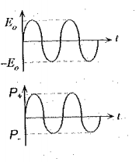
One of the important consequence of non-linear effect is Second Harmonic Generation(SHG).
When an intense light beam of frequency ω passing through the appropriate crystal (quartz) and generates a light beam of frequency 2ω.
SHG is based on finite χ2 coefficient in which effect of χ3 is negligible.
For small electric field, the linear relationship exists between E and P.
The optical field E varies sinsoidally with frequency of ω then induced polarization also varies sinsoidally with frequency of ω. Shown in figure below.

Slide 7
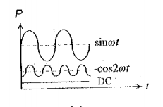
If the field strength is sufficiently large, the induced polarization will not be linear.
The oscillations of dipole moment P now emits waves not only at frequency of ω also at 2ω.in addition dc component is there . It is shown in below figure.
The induced polarization P can be mathematically represented as

Slide 8
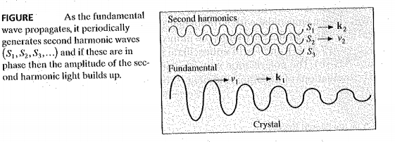
It may thought that second harmonic waves interfere constructively result in a second harmonic light beam just as fundamental.
Normally crystal posses different refractive indices n(ω),n(2ω) for ω-wave,2ω-waves which means ω,2ω waves travel with different phase velocities v1,v2 respectively.
a ω-wave propagates through crystal generates 2ω waves along its path, depicted as s1,s2,s3…. . Shown in figure below

Slide 9
If 2ω-waves are in-phase then they travel with a velocity of ω-wave and they can interfere constructively and constitute a second harmonic beam.
If s1,s2,s3… eventually fall out of phase and destroy each other and there is a no or little second harmonic beam.
the condition for second harmonic waves travels with same velocity of fundamental wave is called phase-matching condition .it is given by
n(ω) = n(2ω)
To separate second harmonic beam from fundamental beam, something like diffraction grating or optical filter should be used at output.

Slide 10
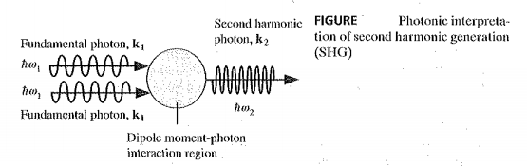
It is instructive to consider SHG in terms of photon interactions shown in figure below.
Two fundamental mode photons interact with dipole-moment and produces single second harmonic photon.
The photon momentum is ћ k
The photon energy is hω

Slide 11
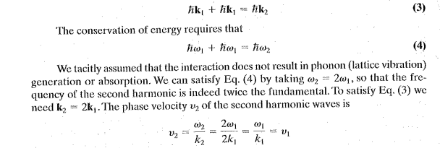
Conservation of momentum requires that
Thus, second harmonic and fundamental photons required to have same phase velocity, It requires K2 = 2 K1 .
If K2 not exactly equal to 2K1 then there is mismatch, then SHG is effective only for limited length lc.lc is the coherence length of second harmonic.

Slide 12
If crystal size is longer than lc,second harmonics interfere randomly with each other and leads to very poor SHG efficiency. Phase matching therefore an essential Requirement for SHG.
The conversion efficiency depends on intensity of exciting laser beam,the materials χ2 coefficient and extent of phase matching.

